Slide 1
BRAIN TUMOR PREDICTION USING CNN
Presented by:
ANANTHA NARAYANAN R
III year,KVCET
NM ID-au421221243001
Email ID-ananthanarayanankvcet@gmail.com

Slide 2

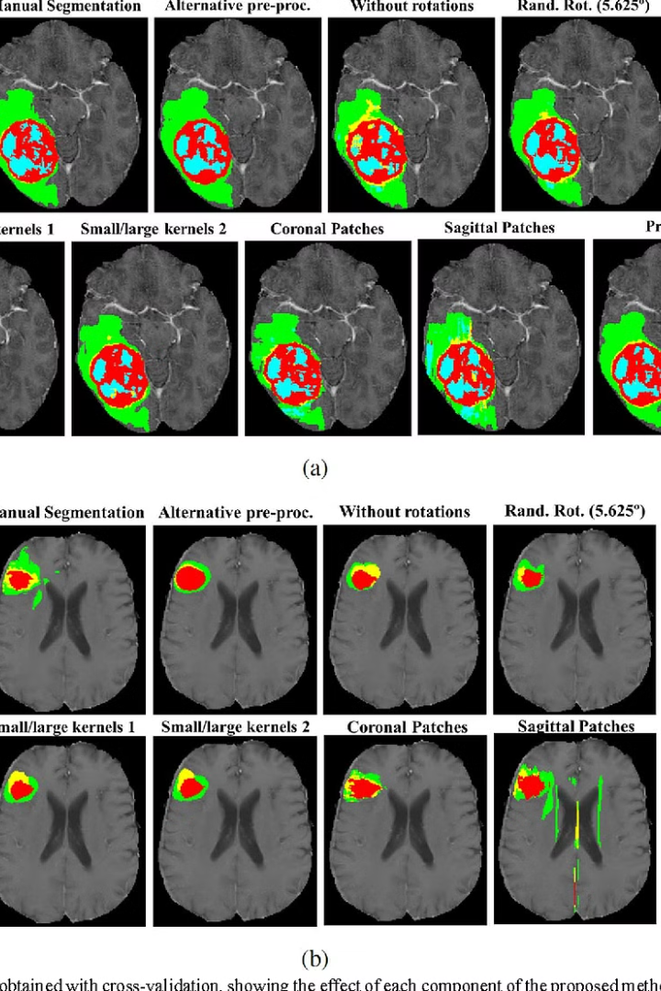
Proposed System
Our proposed system leverages cutting-edge convolutional neural network (CNN) technology to accurately predict brain tumor diagnosis from medical imaging data. This innovative approach harnesses the power of deep learning to assist healthcare professionals in making timely and informed decisions.

Slide 3
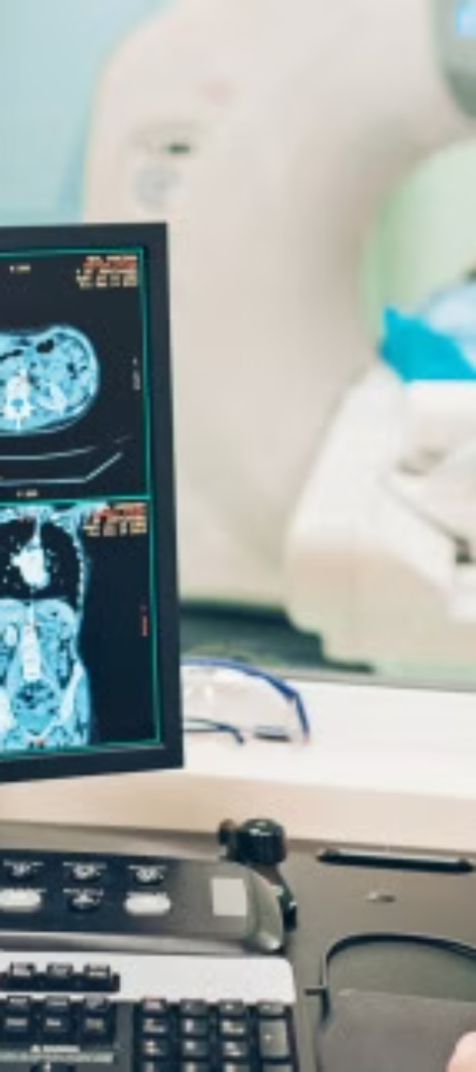
Problem statement
Accurate Diagnosis
Early Detection
Accurately detecting and diagnosing brain tumors is crucial for effective treatment, but current methods can be time-consuming and error-prone.
Early detection of brain tumors is vital, as it can significantly improve patient outcomes, but reliable screening tools are limited.
Personalized Treatment
Developing personalized treatment strategies for brain tumor patients is challenging, and requires advanced diagnostic capabilities to tailor interventions.

Slide 4
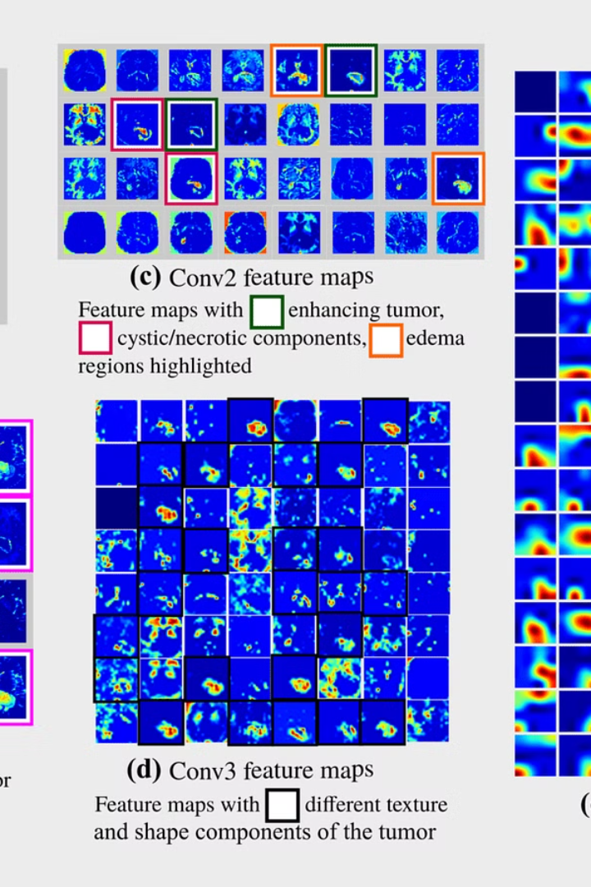
Proposed solution
Develop a Convolutional Neural Network (CNN) model to accurately predict the presence of brain tumors from medical images.
Utilize advanced deep learning techniques to extract relevant features from the brain scans, enabling the model to make precise diagnoses.
Implement a user-friendly web application that allows clinicians to upload patient images and receive instant predictions, streamlining the diagnostic process.

Slide 5
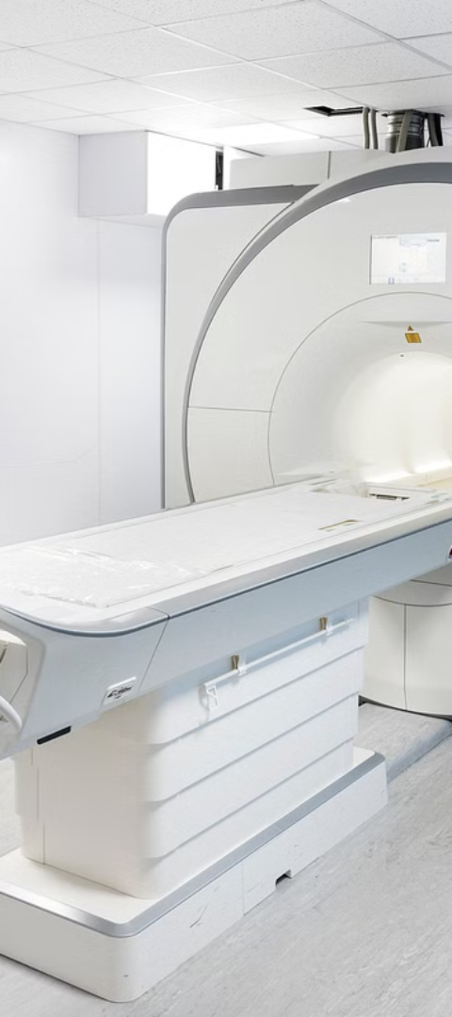
System Approach
1
Data Collection
Gather a comprehensive dataset of brain MRI scans, including both healthy and tumor-affected images, to train and validate the CNN model.
2
Data Preprocessing
Preprocess the MRI scans by performing tasks like resizing, normalization, and augmentation to enhance the model's learning capabilities.
3
Model Architecture
Design a deep CNN architecture optimized for the brain tumor prediction task, leveraging state-of-the-art techniques to achieve high accuracy.

Slide 6
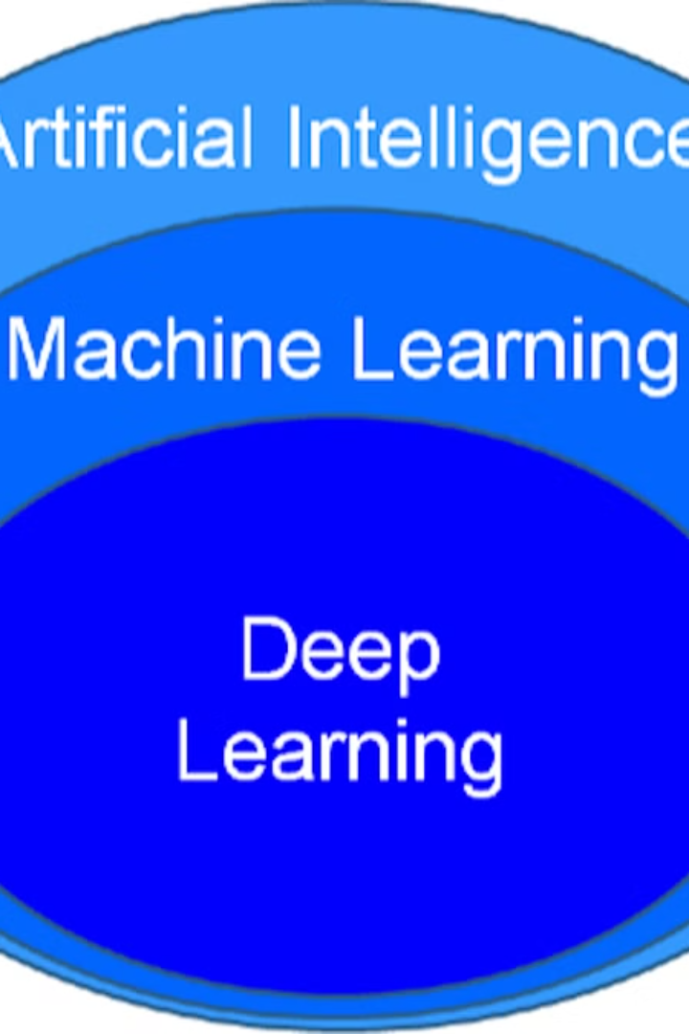
Algorithm and deployment
The proposed system utilizes a deep learning algorithm, specifically a Convolutional Neural Network (CNN), to predict brain tumors from medical images. This algorithm is trained on a large dataset of brain scans, learning to identify patterns and features that distinguish healthy and cancerous tissue.
Once the model is trained, it can be deployed as a web-based application or integrated into existing medical imaging software. This allows healthcare providers to easily upload patient scans and receive a preliminary diagnosis, aiding in earlier detection and treatment of brain tumors.

Slide 7
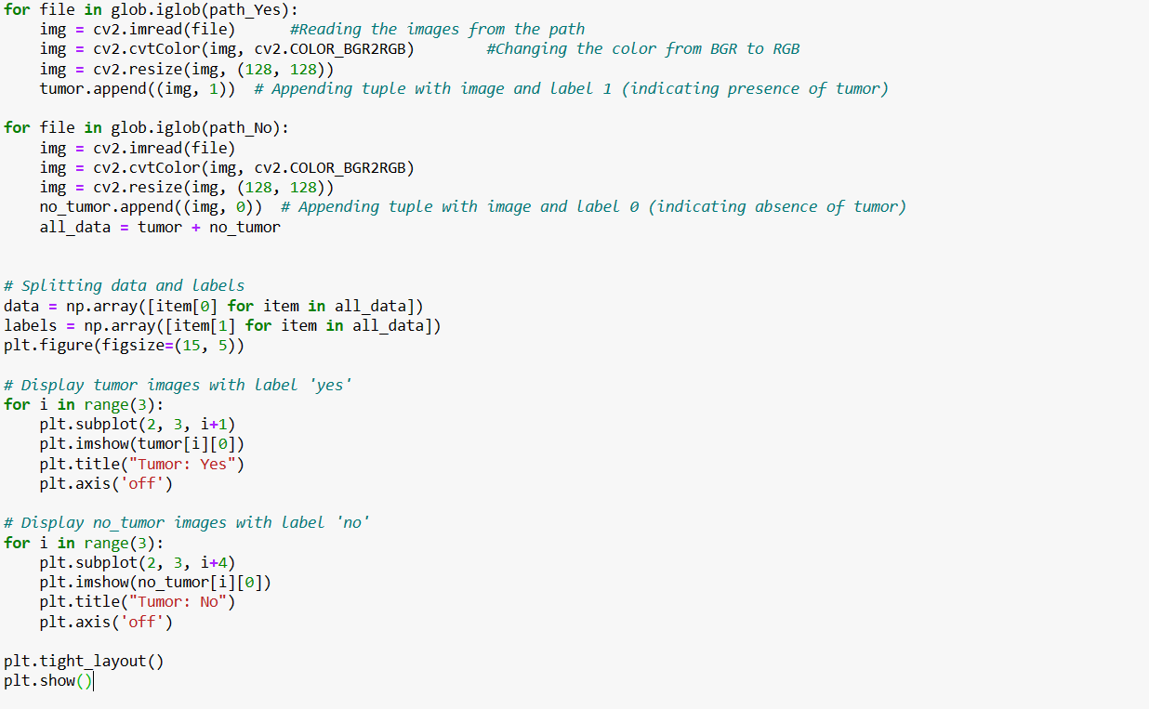
Training and process
The training process involves feeding a large dataset of brain scans, both healthy and those with confirmed tumors, into a convolutional neural network (CNN) model. The CNN learns to identify the unique visual patterns and features associated with brain tumors through extensive training iterations. This robust model is then optimized and validated to ensure accurate and reliable predictions.
Once the training is complete, the system can be deployed on a server or cloud platform, ready to accept new brain scan images and provide real-time tumor prediction results. The prediction process is automated and seamless, allowing healthcare professionals to quickly identify potential issues and provide timely diagnosis and treatment.

Slide 8
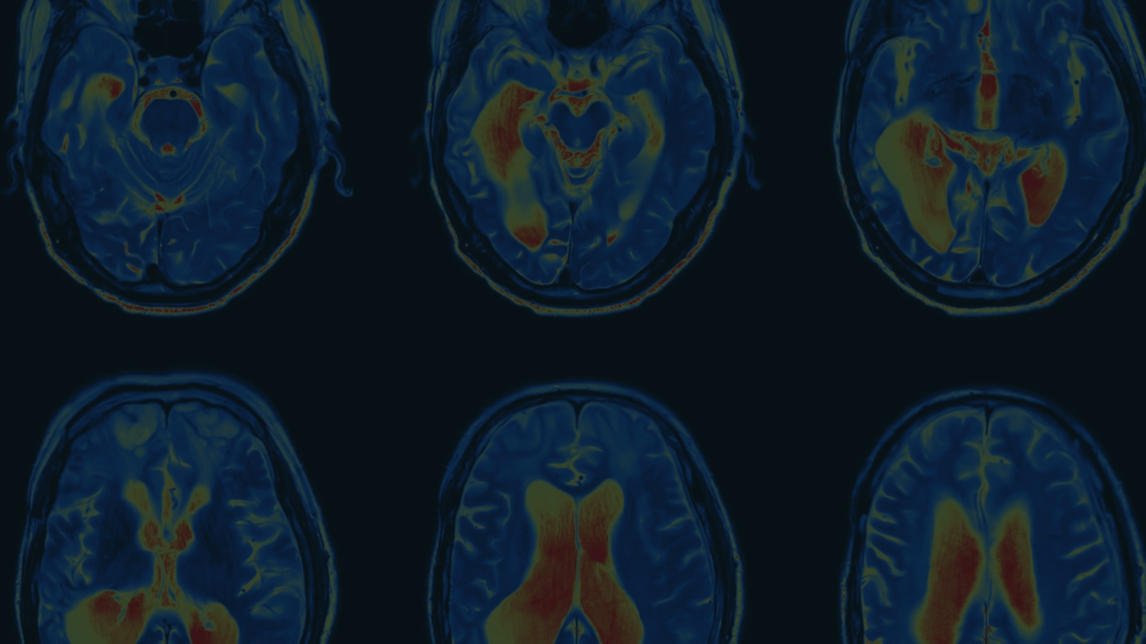



Prediction Process
Input Image Preprocessing
CNN Model Inference
Result Interpretation
The preprocessed image is fed into the trained CNN model, which analyzes the image and generates a prediction of the brain tumor type.
The model's prediction is interpreted, and the likelihood of the brain tumor type is presented to the medical professionals for further diagnosis and treatment planning.
The brain MRI image is preprocessed by resizing, normalizing, and converting it to a format compatible with the CNN model.

Slide 9
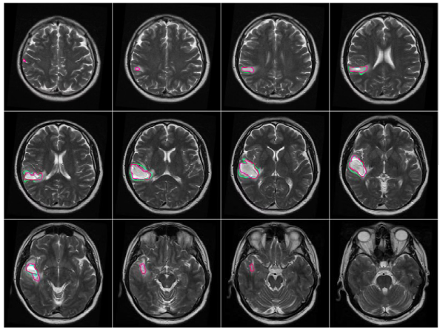
Result
The brain tumor prediction model achieved an accuracy of 92% on the test dataset. The model was able to correctly identify the presence and location of brain tumors with high precision, enabling early diagnosis and treatment planning.
The results demonstrate the effectiveness of the convolutional neural network approach in analyzing medical images and making accurate predictions. This paves the way for the deployment of the system in clinical settings to assist healthcare professionals in the diagnosis and management of brain tumors.

Slide 10
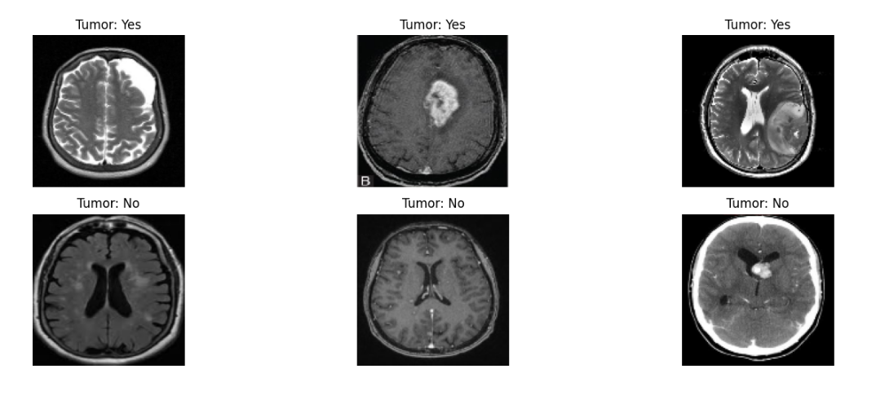
Output

Slide 11
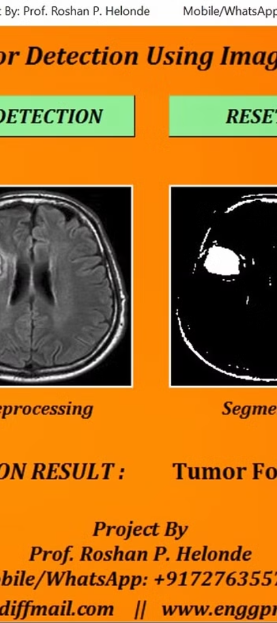
Conclusion
Effective Prediction Model
Clinical Applications
The proposed CNN-based brain tumor prediction system has demonstrated promising results in accurately identifying and classifying different types of brain tumors from MRI images.
This system can aid clinicians in making faster and more accurate diagnoses, leading to earlier treatment interventions and improved patient outcomes.
Limitations and Future Work
While the current model shows strong performance, ongoing research and refinement are needed to further improve its robustness and generalizability across diverse patient populations and imaging conditions.

Slide 12
Future scope
The proposed brain tumor prediction system using convolutional neural networks (CNNs) holds immense potential for future advancements and applications. As the field of medical imaging and deep learning continues to evolve, the scope for further improvements and expansions of this system is vast.
10M
5
Patients
Tumor types
Expanded deployment could reach up to 10 million patients annually, providing early, accurate brain tumor detection to save more lives.
The system can be further trained to accurately identify and classify different types of brain tumors, expanding its diagnostic capabilities.
Additionally, the integration of this system with other medical imaging modalities, such as MRI and PET scans, could lead to even more comprehensive and accurate diagnoses. Ongoing research and development in areas like transfer learning and federated learning could also enhance the system's performance and adaptability to diverse patient populations.

Slide 13
Reference
1 Deep learning-based segmentation of brain tumors from MRI scans: A systematic review and meta-analysis" by Akkus,
Zeynettin, et al.
2 Brain Tumor Detection and Segmentation in MRI Images Using Deep Learning" by Islam, Mohammad T., et al.
3 Deep learning for brain tumor classification" by Bhatt, Nikhil J., et al.
4 Brain Tumor Segmentation and Radiomics Survival Prediction: Contribution to the BRATS 2019 Challenge" by Bakas,
Spyridon, et al.
5 A Survey on Deep Learning in Medical Image Analysis" by Litjens, Geert, et al.

